Slide 1
X y z
dcm
position
=
3D
Key points

Slide 2
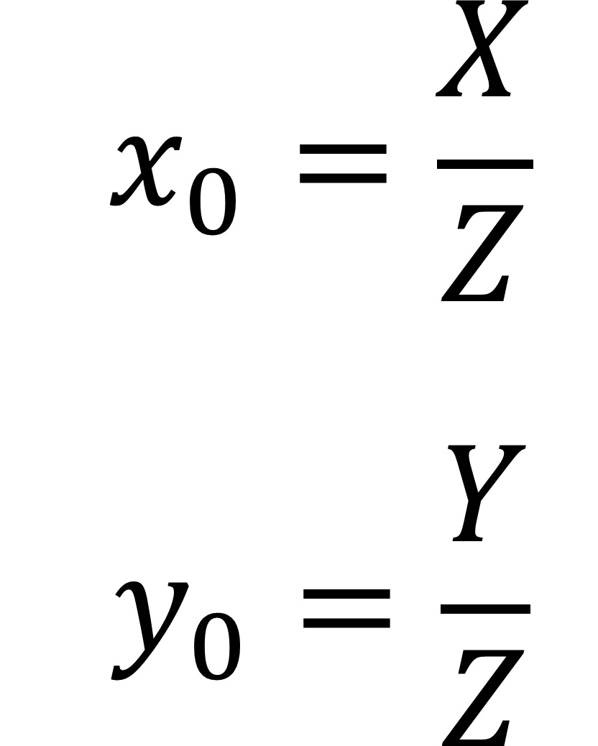
$$x_{0}=\frac{X}{Z}$$ $$y_{0}=\frac{Y}{Z}$$

Slide 3
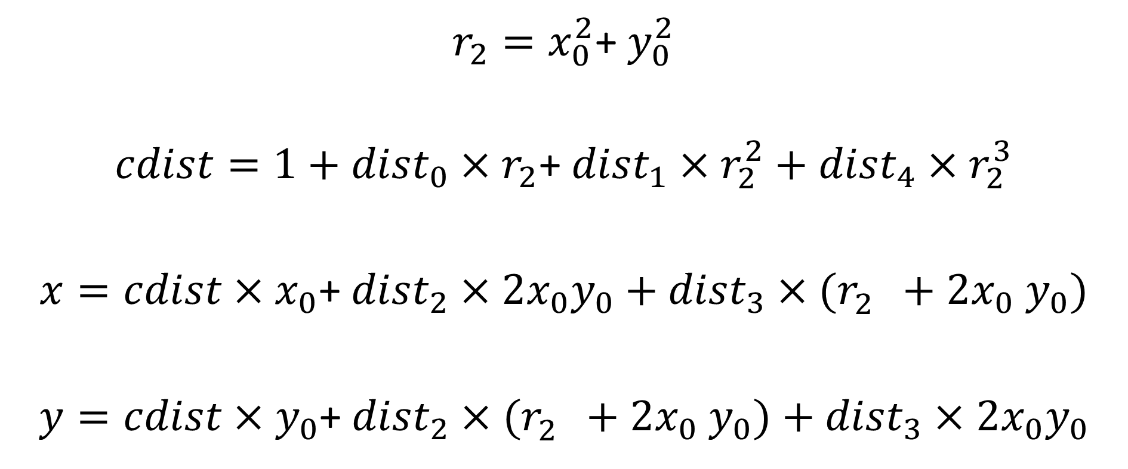
$r_{2}=x_{0}^{2}$+ $y_{0}^{2}$
$cdist=1+{dist}_{0}×r_{2}$+ ${{dist}_{1}×r}_{2}^{2}+{{dist}_{4}×r}_{2}^{3}$
$x=cdist×x_{0}$+ ${dist}_{2}×2x_{0}y_{0}+{{dist}_{3}×(r}_{2}^{}+2x_{0}$ $y_{0})$
$y=cdist×y_{0}$+ ${{dist}_{2}×(r}_{2}^{}+2x_{0}$ $y_{0})+{dist}_{3}×2x_{0}y_{0}$

Slide 4
2D key points =
$${camera}_{0,0}×x+{camera}_{0,2}$$
$${camera}_{1,1}×y+{camera}_{1,2}$$

